Slide 1
NOVEL METHOD FOR HANDWRITTEN DIGIT RECOGNITION SYSTEM
SRIDHAR p (TL)
RANJITHKUMAR R
KARTHI D
MEGANATHAN T
(SENGUNTHAR ENGINEERING COLLEGE TIRUCHENGODE)

Slide 2
MAIN GOAL & APPLICATIONS
Handwritten Digit Recognition is used to recognize the Digits which are written by hand.
A handwritten digit recognition system is used to visualize artificial neural networks.
It is already widely used in the automatic processing of bank cheques, postal addresses, in mobile phones etc.,

Slide 3
Introduction
Scientists believe that the most intelligent device is the Human Brain.
There is no computer which can beat the level of efficiency of human brain. These Inefficiencies of the computer has lead to evolution of “ Artificial Neural Network”.
They differ from conventional systems in the sense that rather than being programmed these system learn to recognize pattern.

Slide 4
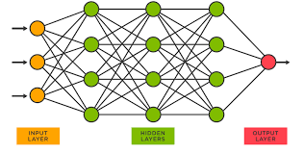
What are Neural Networks?
Artificial neural networks ,usually called neural networks(NNs),are interconnected systems composed of many simple processing elements(neurons)operating in parallel whose function is determined by-
1)Network Structure
2)Connection Strengths
3)The Processing performed
at Computing elements or
nodes.

Slide 5
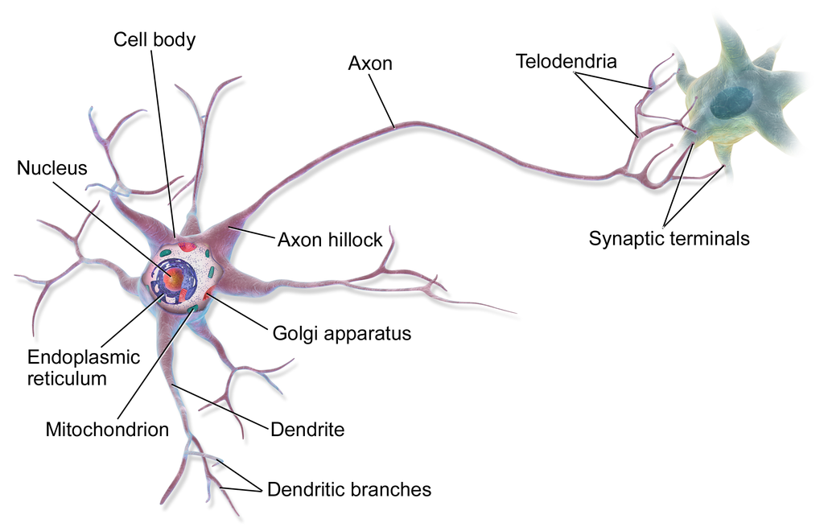
A neural cell in the brain

Slide 6
Training Dataset
Training of the network is done by a dataset named MNIST dataset.
MNIST dataset has a training set of 60,000 examples, and a test set of 10,000 examples.
All the images in the dataset are of 28x28 pixels.

Slide 7
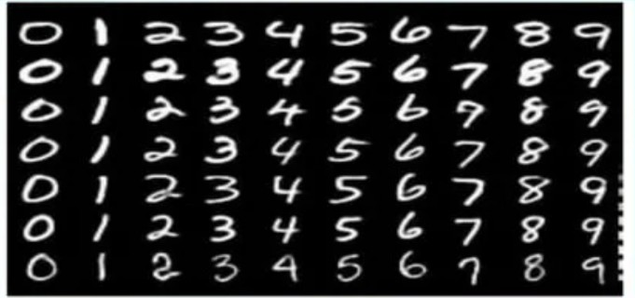
It is a good database for people who want to try learning techniques and pattern recognition method on real-world data while spending minimal efforts on preprocessing and formatting.

Slide 8
Why Convolutions?
Convolution is a simple mathematical operation between two matrices in which one is multiplied to the other element wise and sum of all these multiplications is calculated.
Convolutions are performed for various reasons-
Convolutions provide better feature extraction.
They save a lot of computation compared to ANNs.
Less number of parameters are created than those in pure fully connected layers.
Due to less number of required parameters, lesser fully connected layers are needed.

Slide 9
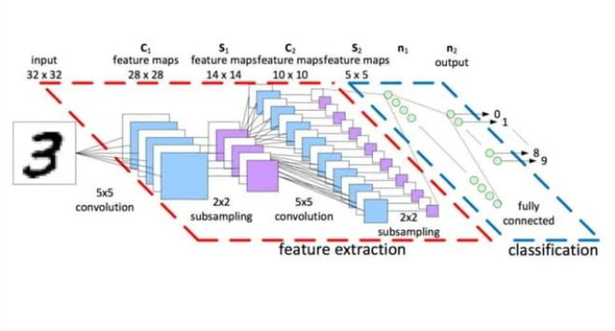
Architecture of a Convolutional Neural Network

Slide 10
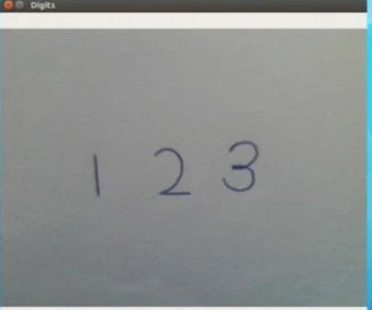
Images are taken using webcam
To take images from webcam, opencv functions have been used.

Slide 11
Pre-Processing of images
Pre-processing of images is done using a python library called Opencv.
It has certain functions which can be implemented to make necessary changes in the image before passing them to network.
Gaussian blur
- Gaussian blur is a function for smoothening an image.
Adaptive-Threshold
- In Adaptive-Threshold, the algorithm calculate the threshold for a small regions of the image. So we get different thresholds for different regions of the same image and it gives us better results for images with varying illumination.
Dilation
- Dilation is done to make the digits bigger.
- Dilation is very useful in cases where digits have holes as noises in them.
Erosion
- Erosion is done to make the digits smaller or thinner.
- This reduces the noise as thin noises get vanished after erosion.

Slide 12
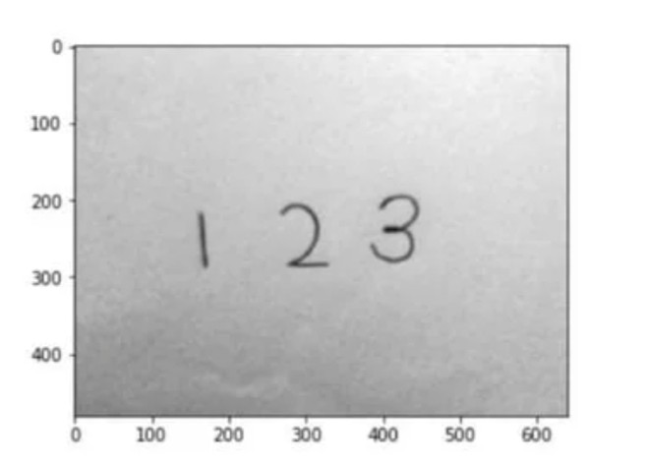
Image after Gaussian Blur

Slide 13
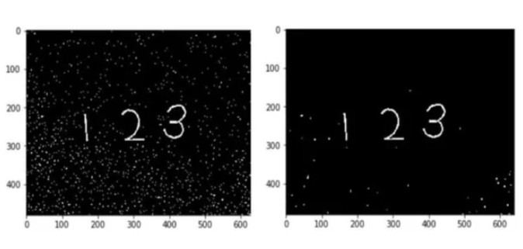
Image after Adaptive Threshold Image after Dilate and Erode

Slide 14
Segmentation
Segmentation of the image is done by the concept contours in Opencv
Contours
- Contours can be explained as simply curve joining all the continuous points, having same color or intensity
- The contours are a useful tool for shape analysis and object detection and recognition.

Slide 15
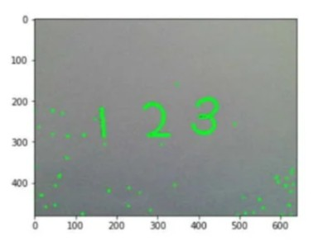
Image after contour extraction

Slide 16
Convolutional Neural Network Architecture
This model’s architecture consists of three main parts, two convolutional blocks and one fully connected neural network layer.
The inputs to this model are 28x28 images.
First Convolutional Block:
A 28x28 image is taken as input to this block. A padding of 2 units is added to the image so as to retain its dimensions after a convolution operation on the image by 16 5x5 filters/kernels.
The output of the convolution gives 16x28x28 volume, which is then input to a ReLU activation function followed by a MaxPool operation. ReLU activation is used to introduce some non-linearity.
This block outputs a 16x14x14 volume.

Slide 17
Second Convolutional Block
First step is again a convolution operation on 16x14x14 by 32 5x5kernels with padding of 2 units, obtaining a 32x14x14 volume.
It is passed through a ReLU activation followed by a MaxPool operation.
Second convolutional block outputs a 32x7x7 volume.
Fully connected Neural Layer:
Here, a single hidden layer of 10 nodes is taken as the fully connected layer.
Finally, the output of the fully connected layer is passed to a softmax function to obtain the output result of recognition.

Slide 18
Conclusion
The handwritten digit recognition using convolutional neural network has proved to be a fairly good efficiency.
It works better than any other algorithm, including artificial neural networks.

Slide 19
THANK YOU

